Slide 1
WORLD OF DRONE
Drone Application: Monitoring

Slide 2
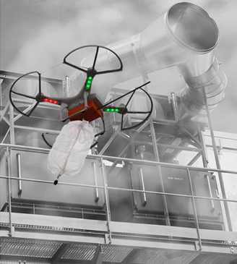
?
Drone Application: Monitoring
UAVs equipped with air quality monitors provide real time air analysis at various elevations.

Slide 3
?
Drone Application: Monitoring
They can be used for monitoring many types of natural phenomenon such as flooding, volcanic eruptions, glaciers, tsunami, earthquakes, storm and hurricanes.

Slide 4
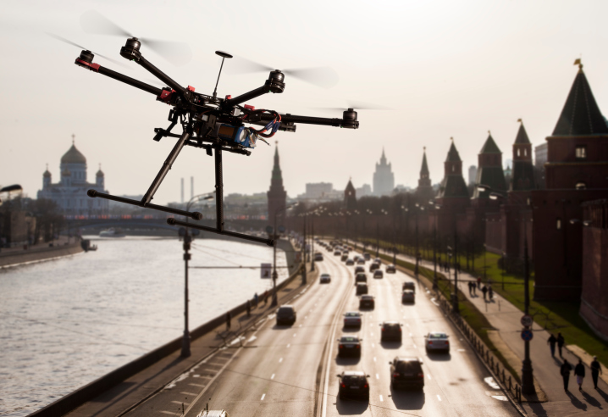
Drone Application: Monitoring
In addition, UAV allos us to monitor road traffic, critical infrastructure of buildings, illegal ventilation of ship bilges etc.

